Slide 1

Green University of Bangladesh
Department of Computer Science & Engineering
Presented By
Supervisor
MS. Fatema Tuj Johora
Lecturer
Department Of CSE
Green University Of Bangladesh
Shuvobroto Biswas (183002066)
MD. Arobi Emon (183002057)
Susmita Rani (191002139)

Slide 2
Outline
Introduction
Motivation
Objectives
Problem Statement
Related work
Requirements
Methods And Approaches
Proposed System
Use Case Diagram
DFD Diagram
Tools
Limitations
Testing
References

Slide 3
Introduction
Our Social media app is a cross platform software which helps us to find many thing in one app.
Simple and easy to use platform that makes quick finding.
Users can solve their problems through chat.
Users satisfaction and useful features are our main goal.

Slide 4
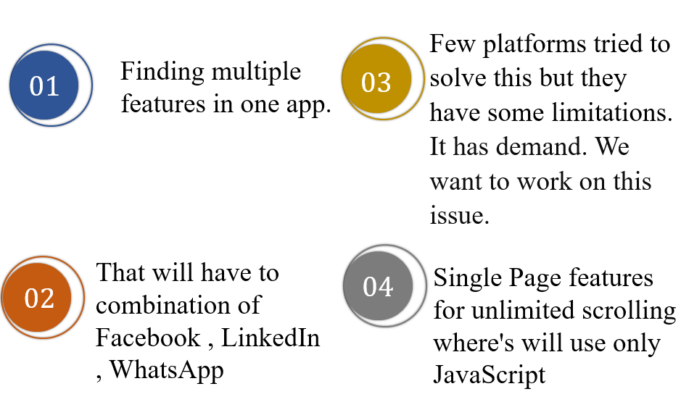
Motivation

Slide 5
Objectives
We will develop an app that will run will be all OS
That app will be super responsive UI based social media app
Our main goal is making an app that will combination of three apps
Fully Encrepted

Slide 6
Problem Statement
THE ISSUES
THE RESOLUTIONS
THE OUTCOMES

Slide 7
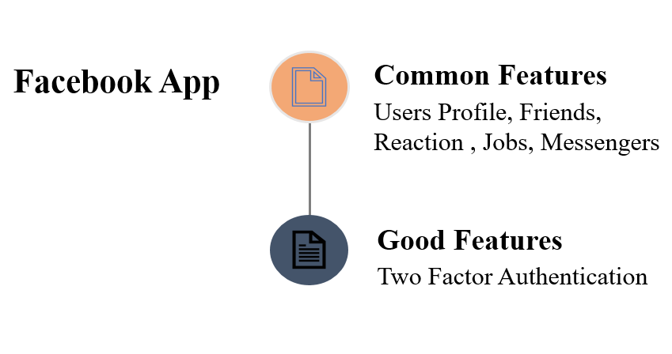
Related Work

Slide 8
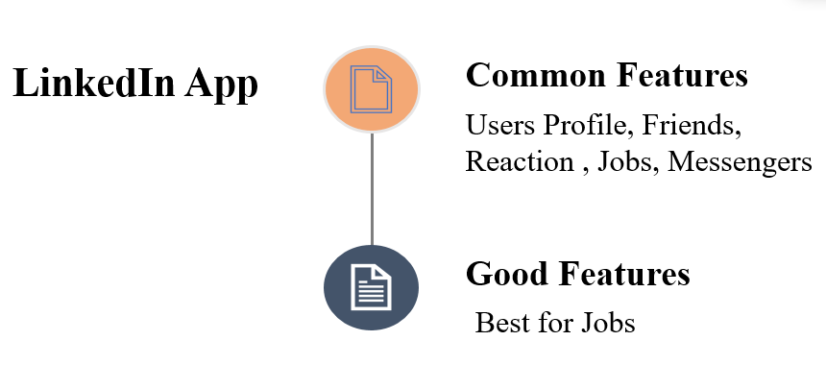
Related Work

Slide 9
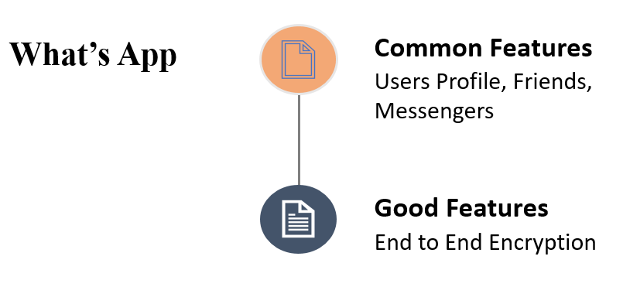
Related Work

Slide 10
Requirements
Functional Requirements | Non-Functional Requirements | User Requirements
Home Page Friend List Job Board Profile Settings Messenger | Performance Usability Security Portability Helpline | Easy and simple to operate Quick response Effectively Handling Operational Errors User Support

Slide 11
Methods And Approaches
Setup Environment
Database
Ready SDK
Integrate APIS
Opening Dev Server
Ready to Build ALL OS
Coding
Publish to Stores
Make UI

Slide 12
Proposed System
Proposed Systems:
Our software will provide some unique features along with emergency help center .
Also keep some information about-
Make friend
Post job
Employee onboarding
Location recognition
Profile settings

Slide 13
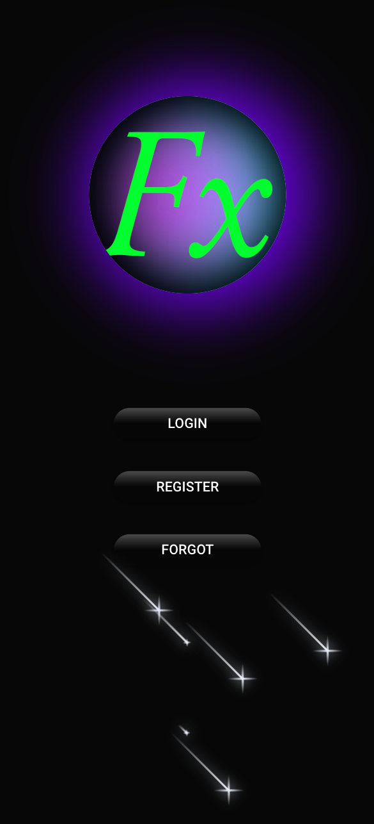
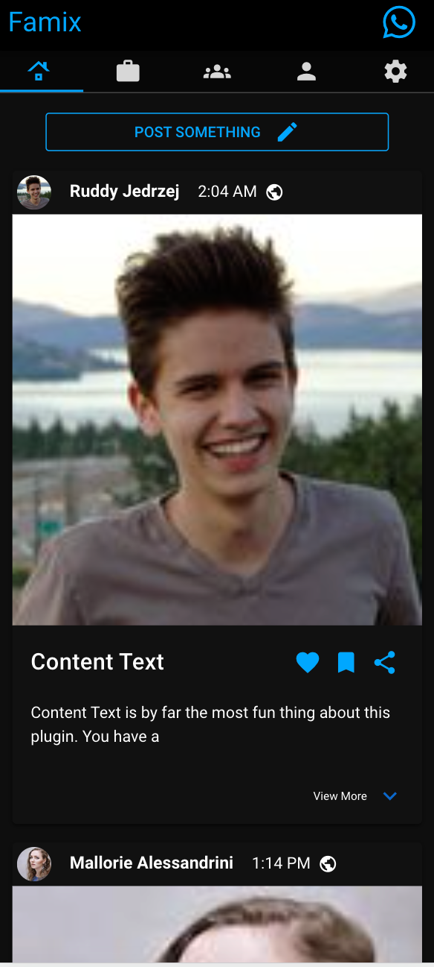
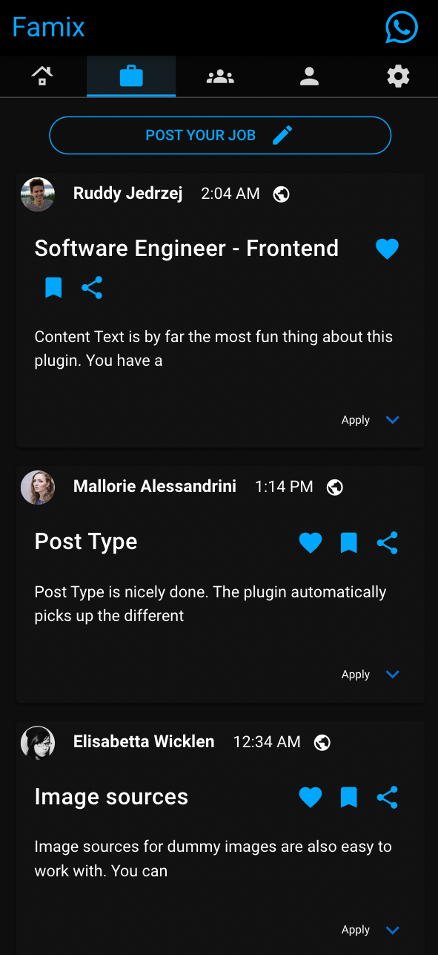
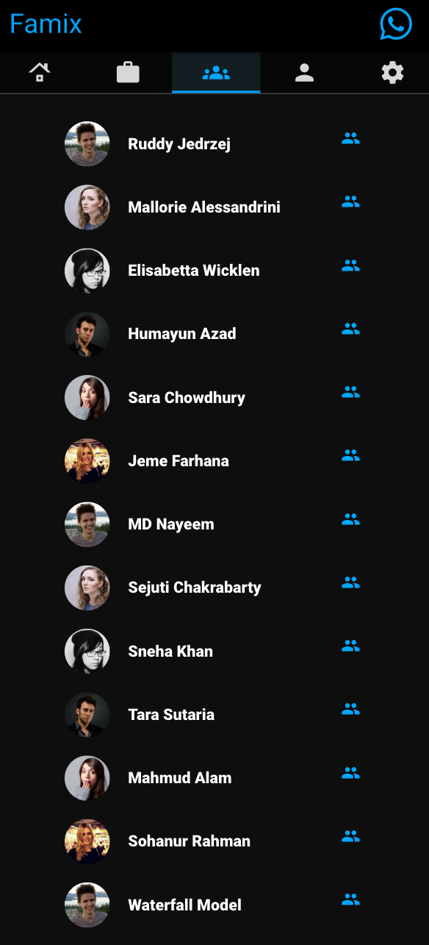
Login Window
Newsfeed Window
Job Board
Friend List Window

Slide 14
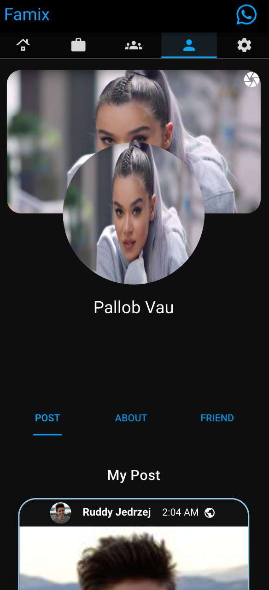
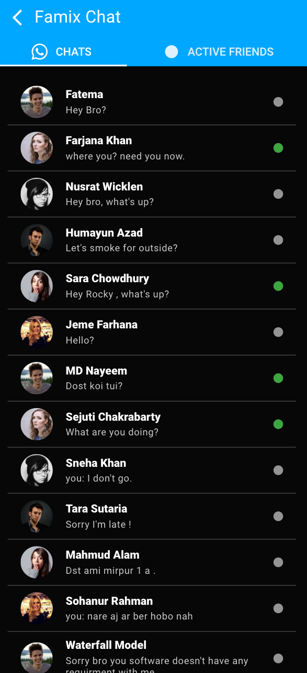
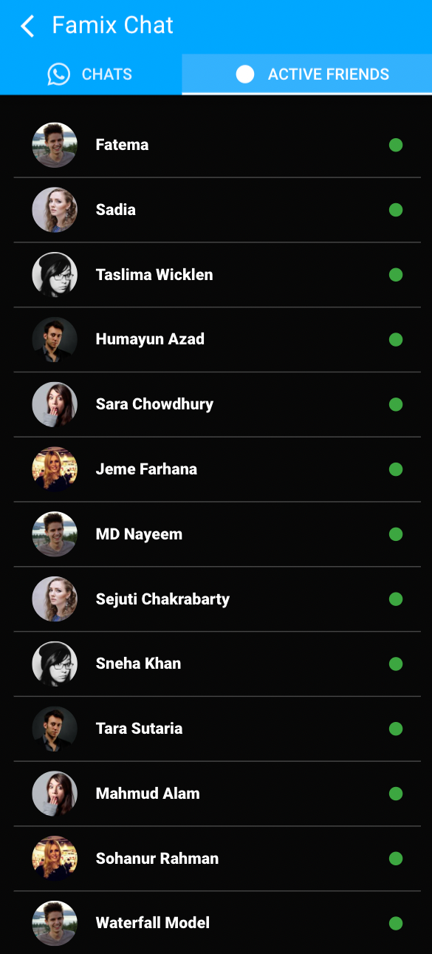
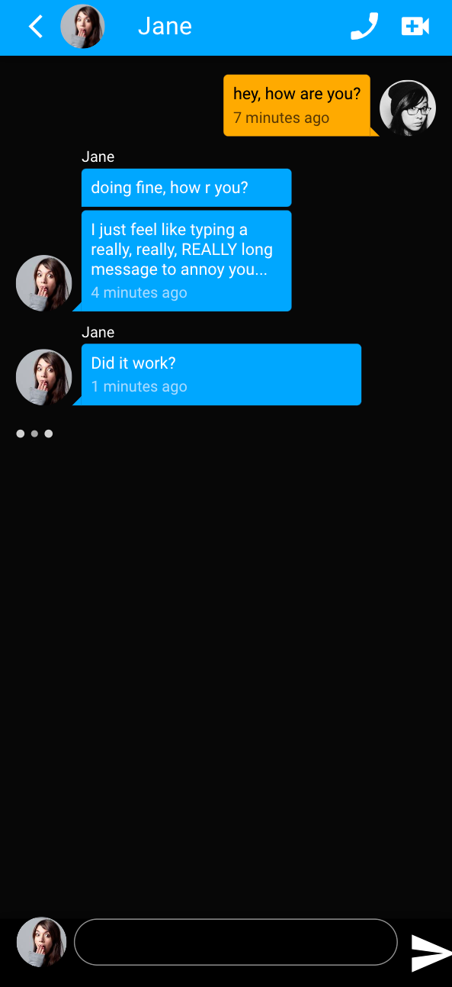
My Profile Window
Chat Window
Active Chat Window
Messenger Sections

Slide 15
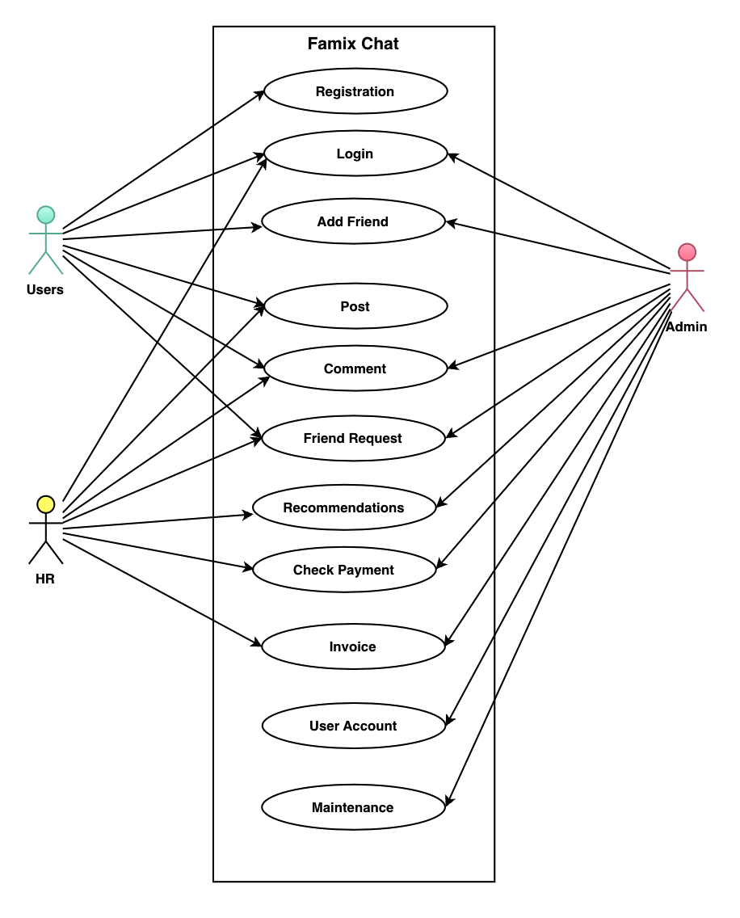
Use Case Diagram

Slide 16
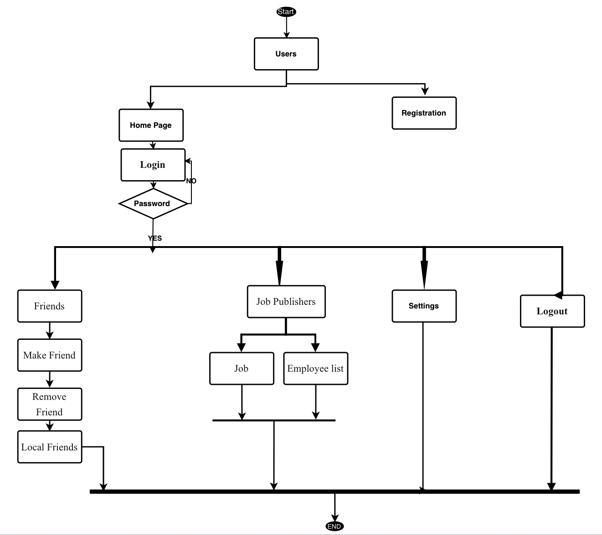
Data Flow Diagram

Slide 17
Tools
Front-End: Vue , Quasar , Node js , JavaScript ,Typescript , SASS , SCSS ,LESS
Programming Language: JavaScript , Typescript, Python , NoSQL.
Back-End: Postgres , MongoDB, Django
Server: AWS .

Slide 18
Limitation
Our software’s limitations:
Minimal user interface
No data recodes
No Ads facilities

Slide 19
Testing
Testing Techniques | Activities
Functionality Testing | test user interface, APIs, database testing, security testing, client and server testing and basic website functionalities
2. Usability testing | Test the site Navigation, Test the Content
3. Interface Testing | Application, Web and Database Server
4. Database Testing | Test if any errors, Data Integrity is maintained while creating, updating or deleting data, Check response time of queries
5. Compatibility testing | Test if our web application is being displayed correctly across browsers, JavaScript and authentication is working fine
6. Performance Testing | response times at different connection speeds, Load test , Stress test, Test if a crash occurs due to peak load
7. Security testing | Test unauthorized access, Restricted files should not be downloadable

Slide 20
References
[1] Jack Wallen , You don’t enable e2e on Facebook Messenger globally. Instead, you enable it for individual contacts. To start an e2e encrypted chat with a contact, open the Facebook Messenger app. Next, tap the profile icon of the contact for which you want to switch on e2e encryption, and then, in the conversation window, tap their profile icon again. (https://www.techrepublic.com/article/how-to-enable-end-to-end-encryption-in-facebook-messenger/) , February 9, 2022, 7:07 AM PST
[2] Facebook said that it will roll out end-to-end encryption on Facebook Messenger improve security on the said platforms . The company has now rolled out end-to-encryption on Facebook Messenger on voice and video calls. doing another layer of privacy on the platform, and rather soon, given the company had made the announcement in May itself. End-to-end encryption was rolled out on Messenger texts earlier both WhatsApp and Facebook Messenger now have end-to-end encryption. Facebook said that in the coming weeks, people will get access to more features within the encrypted chats that give people better privacy (https://www.news18.com/news/tech/facebook-rolls-out-end-to-end-encryption-on-messenger-voice-and-video-calls-4084049.html) FIRST PUBLISHED:AUGUST 14, 2021, 12:28 IST

Slide 21
Thank You

